Slide 1
Shoe Sensor Figures

Slide 2
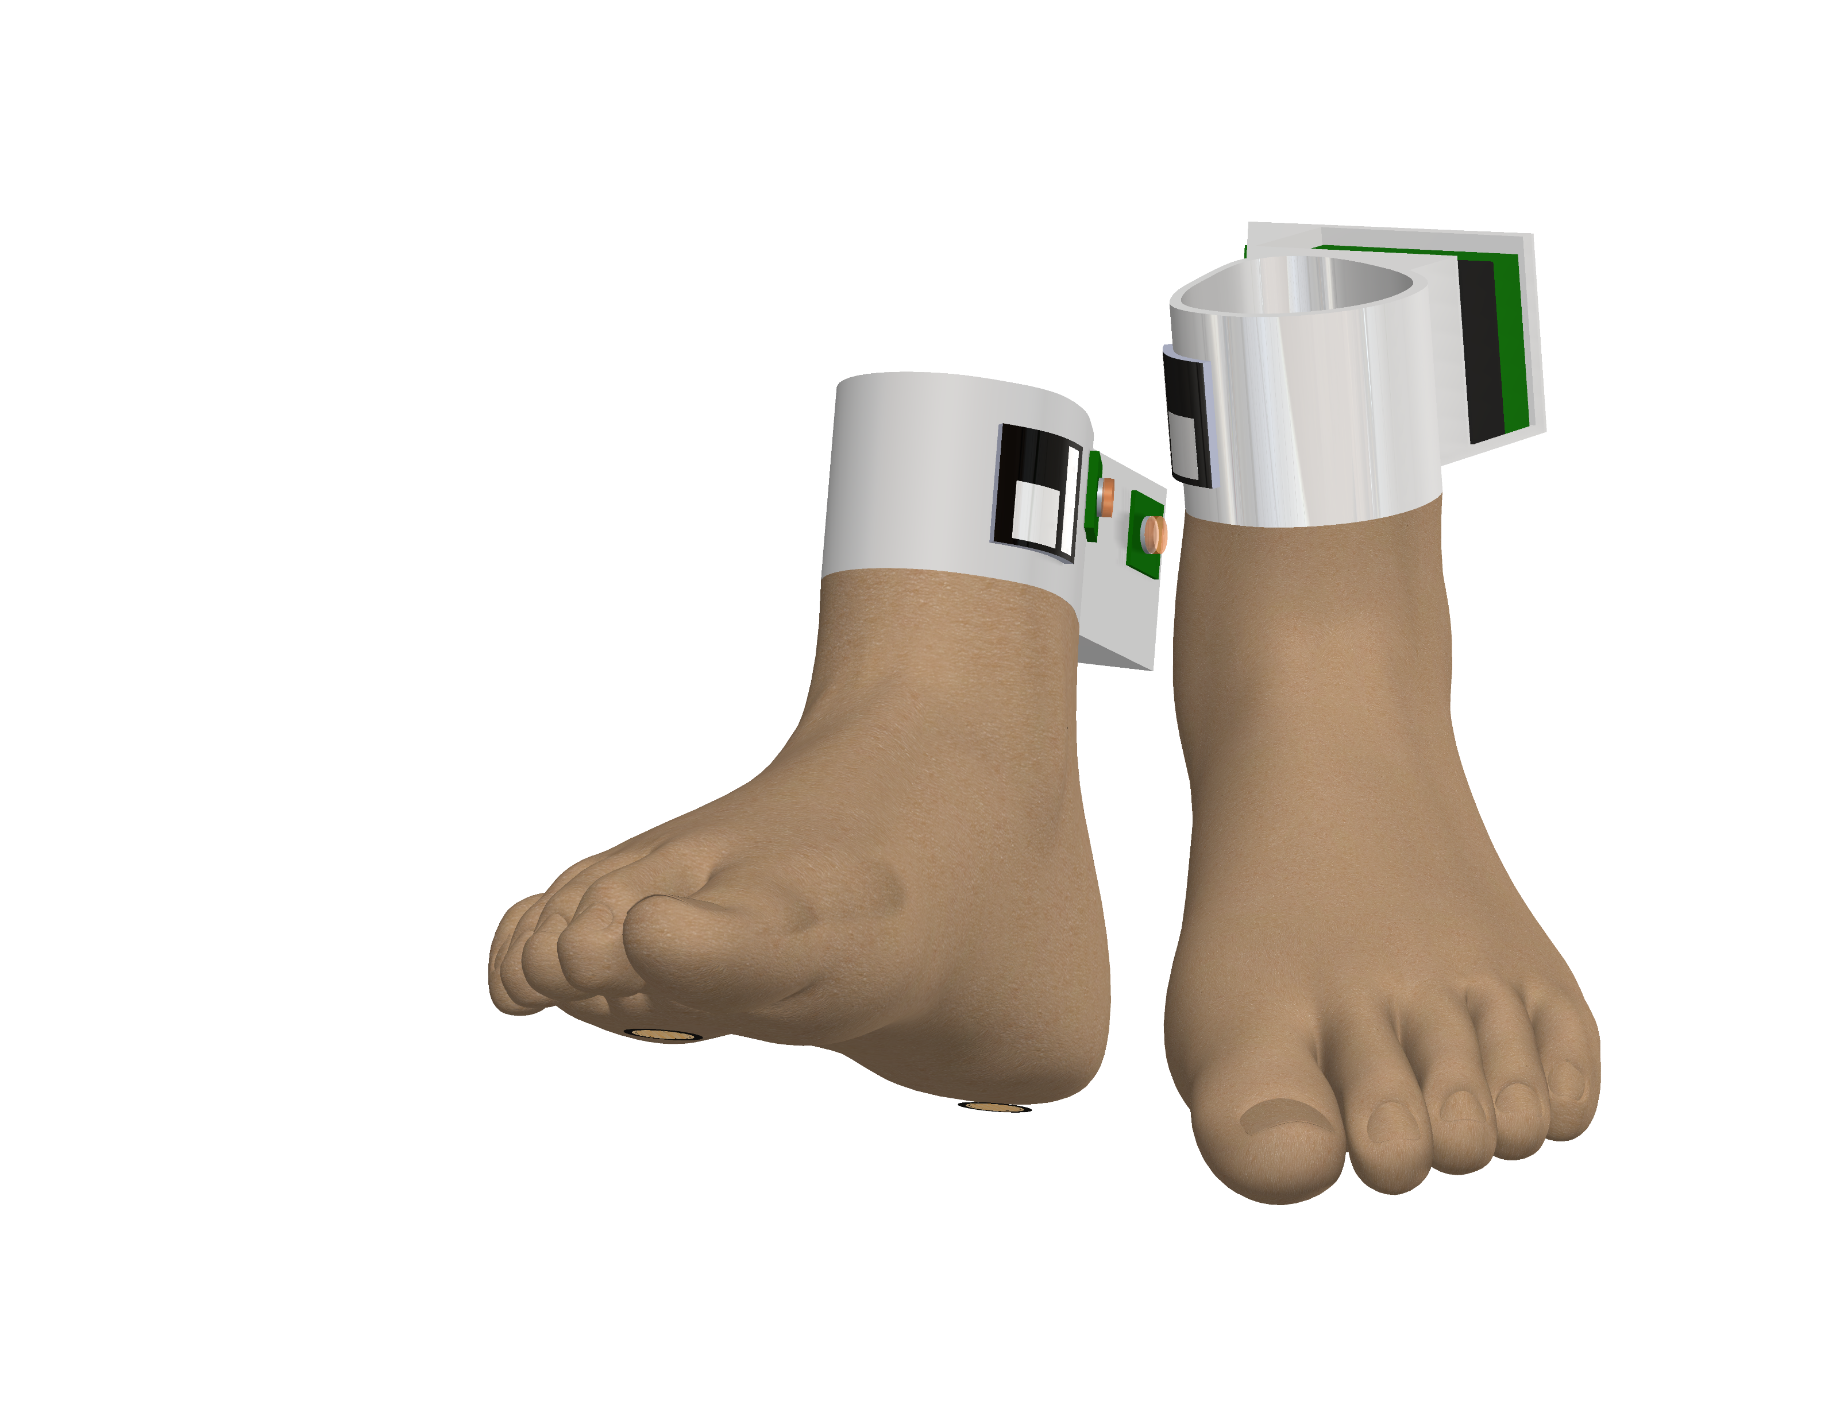
Camera Markers
Raspberry Pi Zero 2 W Boards with Batteries
Force Sensitive Resistor locations on the foot (same on both feet)
Raspberry Pi NoIR V2 Cameras with IR Filter Lenses

